Slide 1
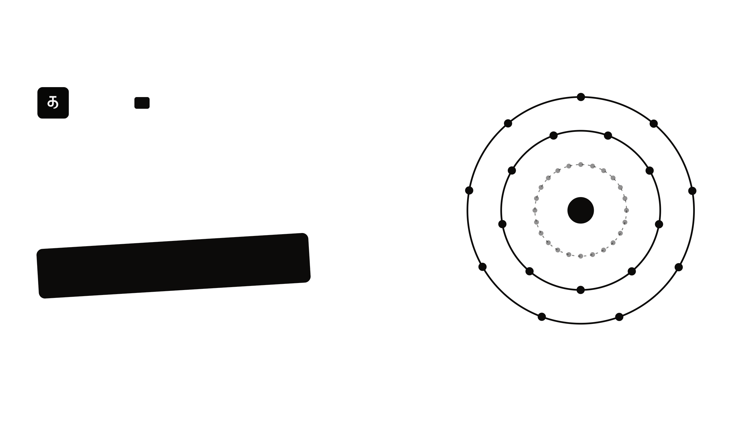
Oozh.
AI
Cause.
Effect.
Intelligence.
Pitch deck · October 2026
pitch.oozh.ai
Notes:
Oozh.
AI
Cause.
Effect.
Intelligence.
Pitch deck · October 2026
pitch.oozh.ai

Slide 2

WHAT WE DO
Oozh uses AI to explore the web of
cause and effect
from real-world events and
map their impact onto the Indian stock market.
FOR INVESTORS · B2C
FOR INSTITUTIONS · B2B & B2G
See which Indian stocks a news event could move, which way, and
Build and explore the cause-and-effect web, then steer it on your
why.
own terms.
Oozh
02 / 11
Notes:
WHAT WE DO
Oozh uses AI to explore the web of
cause and effect
from real-world events and
map their impact onto the Indian stock market.
FOR INVESTORS · B2C
See which Indian stocks a news event could move, which way, and
why.
FOR INSTITUTIONS · B2B & B2G
Build and explore the cause-and-effect web, then steer it on your
own terms.
Oozh
02 / 11

Slide 3
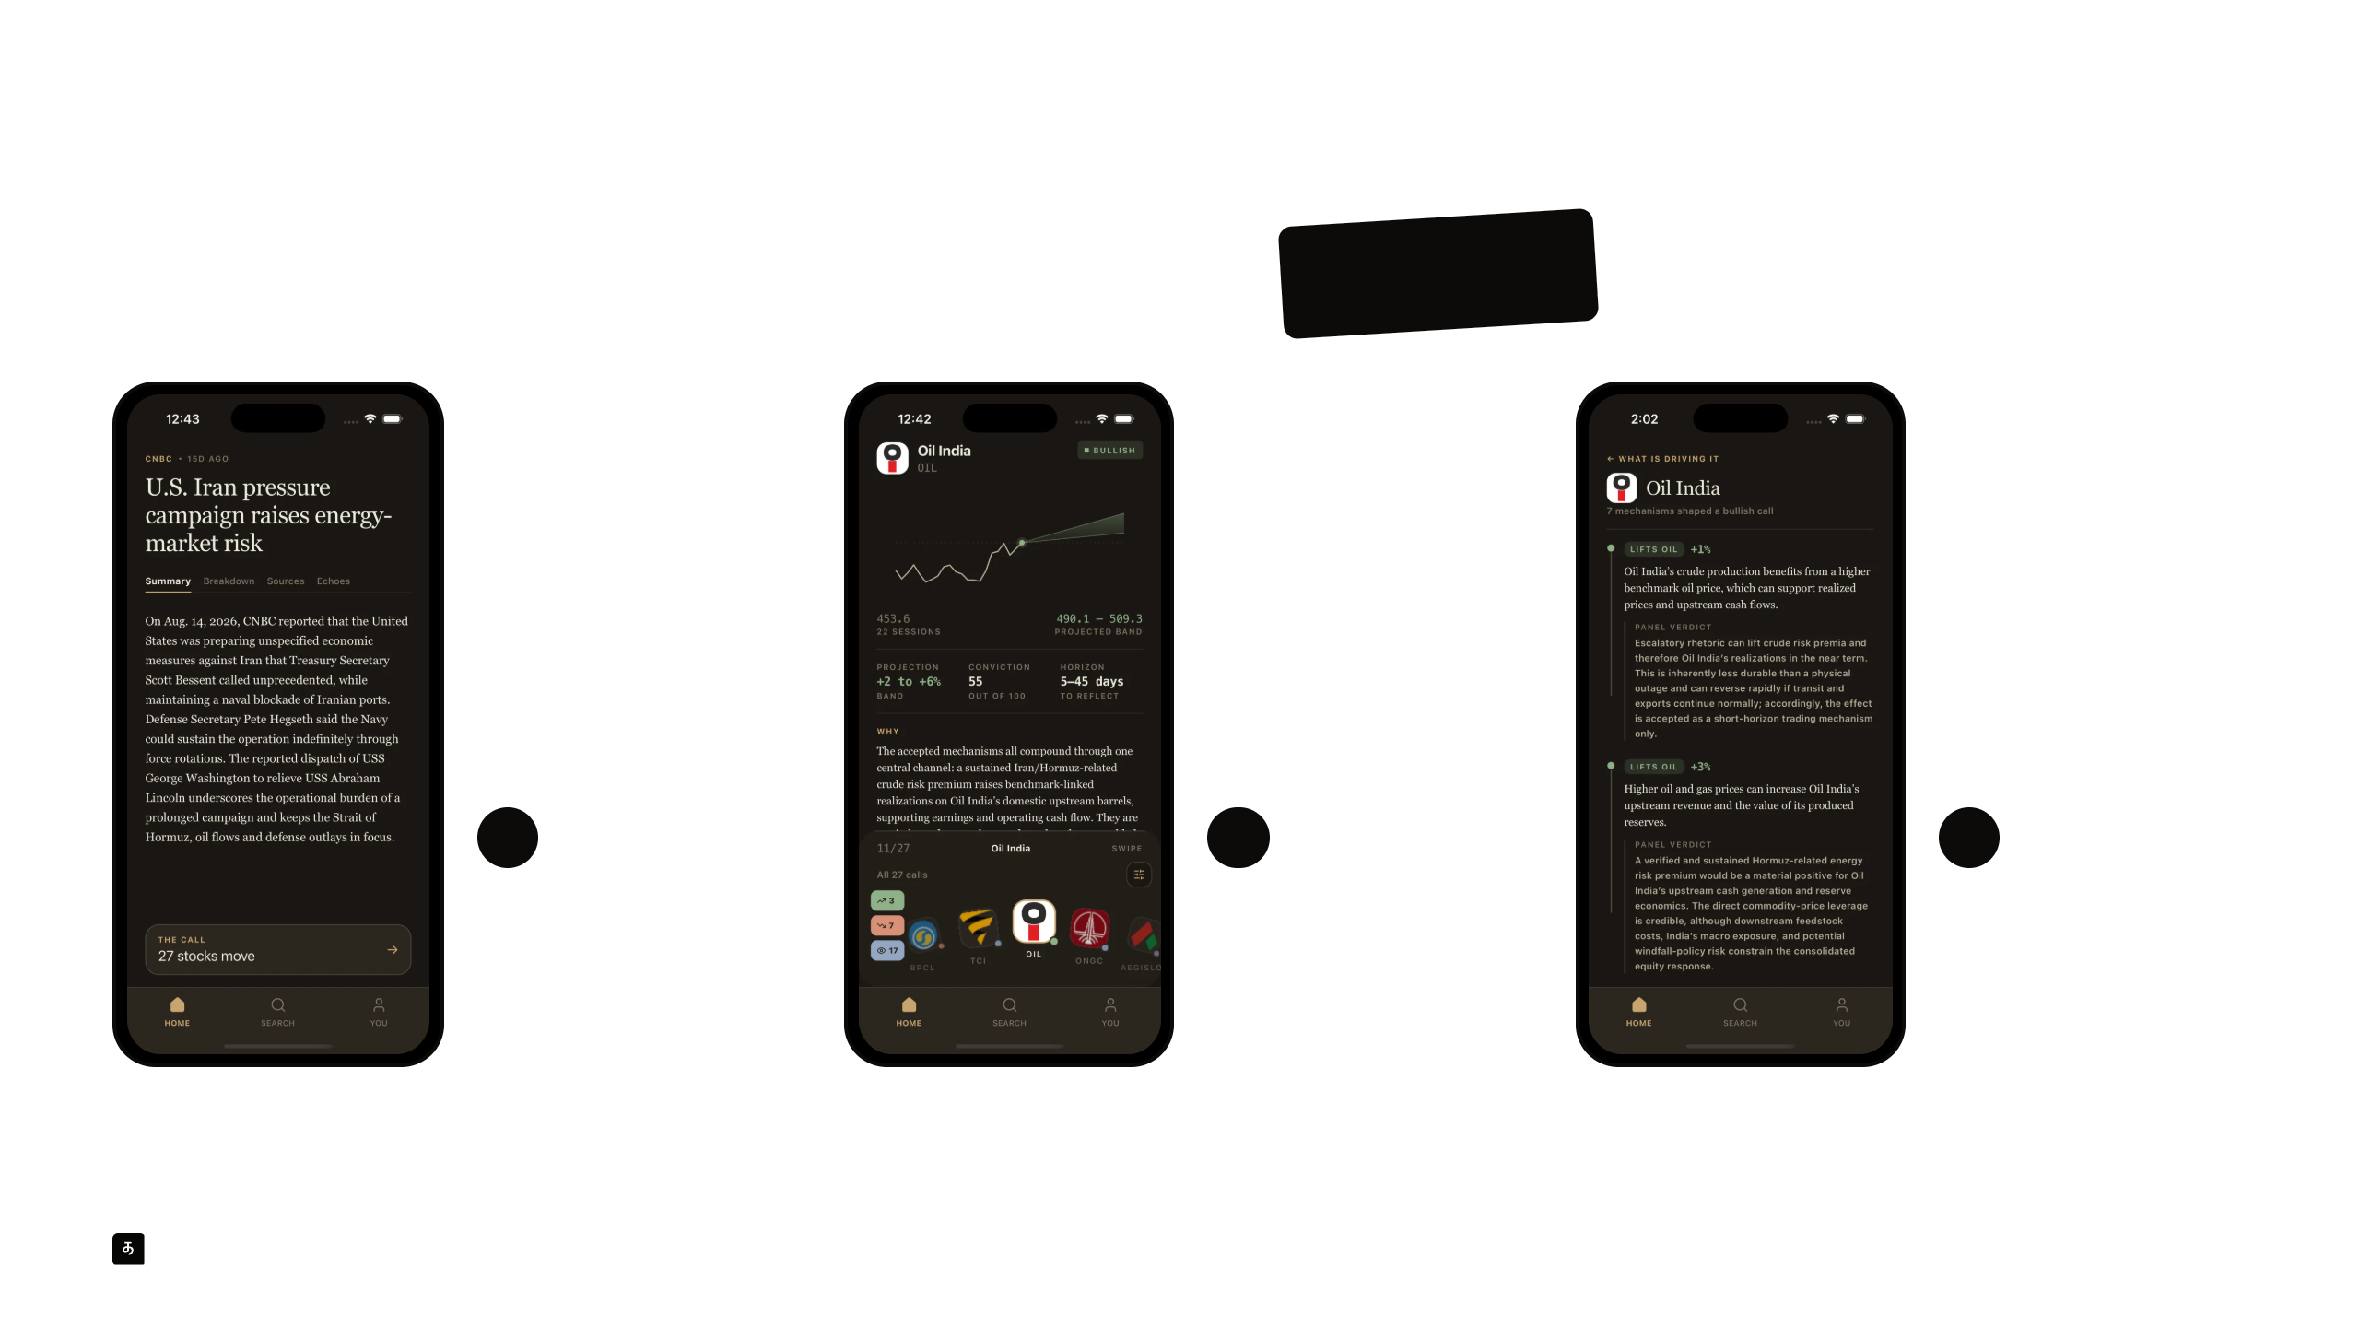
HOW IT WORKS · FOR INVESTORS
Read the story. Swipe left
twice.
1
2
3
The story
The stocks
The reasoning
What happened, who
Which Indian stocks it
Each mechanism behind
says so, and when it
could move, which way,
the view, kept or
happened before.
and how far.
dropped.
Real screens from the Oozh app, on a CNBC story from August 2026. Illustrative only, not investment advice.
Oozh
03 / 11
Notes:
HOW IT WORKS · FOR INVESTORS
Read the story. Swipe left
twice.
1
The story
What happened, who
says so, and when it
happened before.
2
The stocks
Which Indian stocks it
could move, which way,
and how far.
3
The reasoning
Each mechanism behind
the view, kept or
dropped.
Real screens from the Oozh app, on a CNBC story from August 2026. Illustrative only, not investment advice.
Oozh
03 / 11

Slide 4
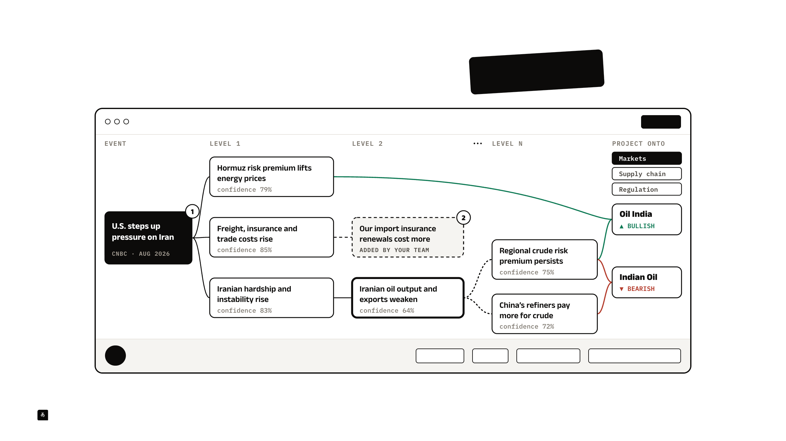
HOW IT WORKS · FOR INSTITUTIONS
Pick an event. Build the web.
Steer it.
Oozh for teams · U.S. pressure on Iran · scope: Indian energy
CONCEPT
3
Selected · Iranian oil output and exports weaken · 64%
Go deeper
Branch
Add an effect
Change an assumption
Concept design on real engine output. The team-added effect is an example.
Oozh
04 / 11
Notes:
HOW IT WORKS · FOR INSTITUTIONS
Pick an event. Build the web.
Steer it.
Oozh for teams · U.S. pressure on Iran · scope: Indian energy
CONCEPT
3
Selected · Iranian oil output and exports weaken · 64%
Go deeper
Branch
Add an effect
Change an assumption
Concept design on real engine output. The team-added effect is an example.
Oozh
04 / 11

Slide 5
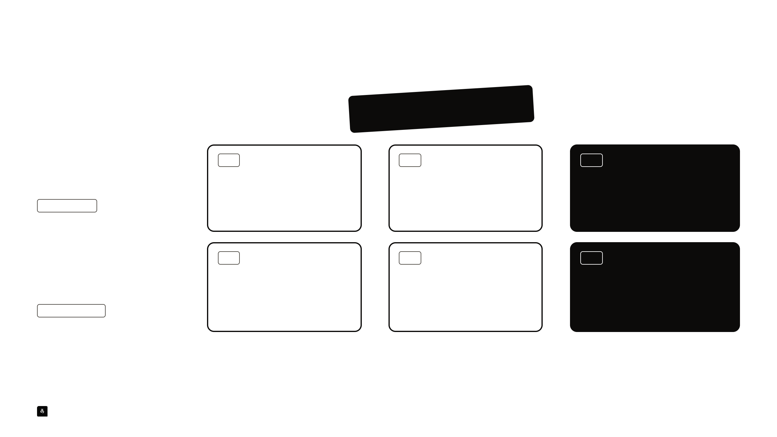
MARKET
Two kinds of buyers,
one engine.
Investors
TAM
SAM
SOM
13.5 crore
10 lakh+
10,000
People who buy Indian stocks · B2C
→
→
registered investors on NSE
already pay for market research
subscribers, our 3-year goal
₹299 A MONTH
NSE, Aug 2026 · 135 million
Moneycontrol Pro alone, FY25
Tijori, a similar research product, has
15,000 paying
Institutions
TAM
SAM
SOM
1.08 lakh
2,350
100
Research, risk, strategy and policy teams ·
→
→
B2B & B2G
organisations with 100+ staff, plus
already pay for one Indian research
organisations, our 3-year goal
₹4 LAKH A YEAR
research firms
platform
Prewave, which maps world events to
CompanyData, RevenueBase, 2026
Tracxn alone, June 2026
business impact, serves 200+ enterprises
Every figure is sourced in appendix A1, with the detail in A2 and A3.
Oozh
05 / 11
Notes:
MARKET
Two kinds of buyers,
one engine.
Investors
People who buy Indian stocks · B2C
₹299 A MONTH
TAM
13.5 crore
registered investors on NSE
NSE, Aug 2026 · 135 million
→
SAM
10 lakh+
already pay for market research
Moneycontrol Pro alone, FY25
→
SOM
10,000
subscribers, our 3-year goal
Tijori, a similar research product, has
15,000 paying
Institutions
Research, risk, strategy and policy teams ·
B2B & B2G
₹4 LAKH A YEAR
TAM
1.08 lakh
organisations with 100+ staff, plus
research firms
CompanyData, RevenueBase, 2026
→
SAM
2,350
already pay for one Indian research
platform
Tracxn alone, June 2026
→
SOM
100
organisations, our 3-year goal
Prewave, which maps world events to
business impact, serves 200+ enterprises
Every figure is sourced in appendix A1, with the detail in A2 and A3.
Oozh
05 / 11

Slide 6
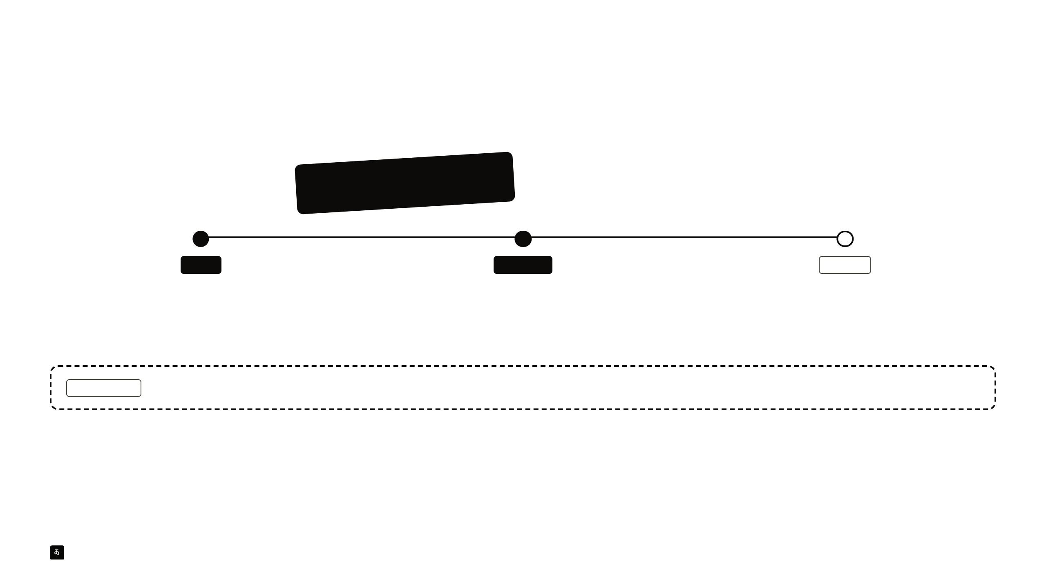
PROGRESS
MVP built in
3 months,
part-time.
BUILD
VALIDATE
ITERATE
App and AI engine
Brokerage feedback
IMM, our way in
Working end to end on real news.
Investors want near-term moves, not
Immediate Market Movement, a short-
long reports.
horizon read of market mood.
IN PROGRESS
SEBI-mandated Research Analyst certification and registration.
The brokerage feedback came from one informal conversation. It is not a partnership, an endorsement or a study.
Oozh
06 / 11
Notes:
PROGRESS
MVP built in
3 months,
part-time.
BUILD
App and AI engine
Working end to end on real news.
VALIDATE
Brokerage feedback
Investors want near-term moves, not
long reports.
ITERATE
IMM, our way in
Immediate Market Movement, a short-
horizon read of market mood.
IN PROGRESS
SEBI-mandated Research Analyst certification and registration.
The brokerage feedback came from one informal conversation. It is not a partnership, an endorsement or a study.
Oozh
06 / 11

Slide 7

INSIGHT
Hidden impacts
for investors.
A
steerable web
for institutions.
FOR INVESTORS · B2C
FOR INSTITUTIONS · B2B & B2G
Oozh builds a deep, multi-level web from each event and
Teams build and steer their own cause-and-effect chain, as
finds its immediate and hidden impacts on Indian stocks, at
deep as they need, and project it onto markets, supply
any level.
chains or regulation.
Immediate-impact analysis is still in development.
Oozh
07 / 11
Notes:
INSIGHT
Hidden impacts
for investors.
A
steerable web
for institutions.
FOR INVESTORS · B2C
Oozh builds a deep, multi-level web from each event and
finds its immediate and hidden impacts on Indian stocks, at
any level.
FOR INSTITUTIONS · B2B & B2G
Teams build and steer their own cause-and-effect chain, as
deep as they need, and project it onto markets, supply
chains or regulation.
Immediate-impact analysis is still in development.
Oozh
07 / 11

Slide 8
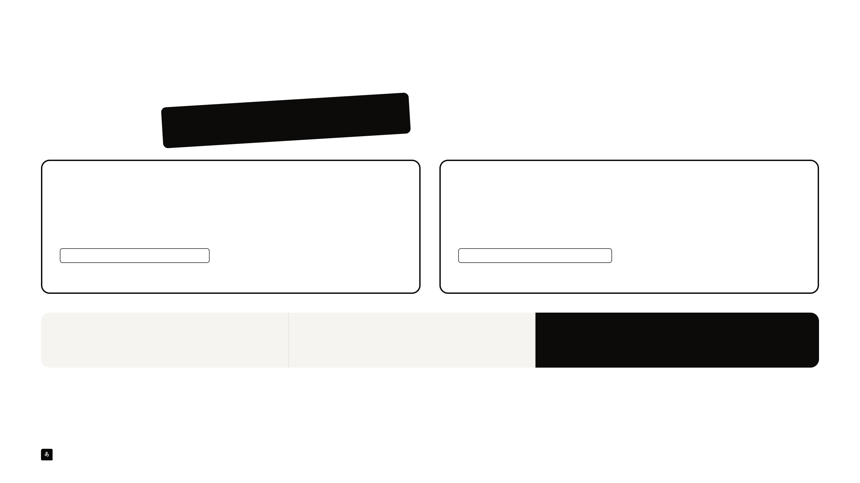
BUSINESS MODEL
We sell
subscriptions.
INVESTORS · B2C
INSTITUTIONS · B2B & B2G
₹299
₹4 lakh
a month
a year
Monthly or annual plan.
Annual licence, starting with a pilot.
PROPOSED, TO TUNE AFTER LAUNCH
PROPOSED, TO VALIDATE IN PILOTS
Tijori charges ₹330 to ₹500 a month.
Tracxn earns about ₹3.6 lakh a year per account.
₹3.6 crore
+ ₹4 crore
≈ ₹7.6 crore a year
10,000 subscribers × ₹299 a month
100 organisations × ₹4 lakh a year
Year-3 goal at full run rate
A target, not a forecast. Assumes every customer pays the stated price. Benchmarks in appendix A2 and A3.
Oozh
08 / 11
Notes:
BUSINESS MODEL
We sell
subscriptions.
INVESTORS · B2C
₹299
a month
Monthly or annual plan.
PROPOSED, TO TUNE AFTER LAUNCH
Tijori charges ₹330 to ₹500 a month.
INSTITUTIONS · B2B & B2G
₹4 lakh
a year
Annual licence, starting with a pilot.
PROPOSED, TO VALIDATE IN PILOTS
Tracxn earns about ₹3.6 lakh a year per account.
₹3.6 crore
10,000 subscribers × ₹299 a month
+ ₹4 crore
100 organisations × ₹4 lakh a year
≈ ₹7.6 crore a year
Year-3 goal at full run rate
A target, not a forecast. Assumes every customer pays the stated price. Benchmarks in appendix A2 and A3.
Oozh
08 / 11

Slide 9
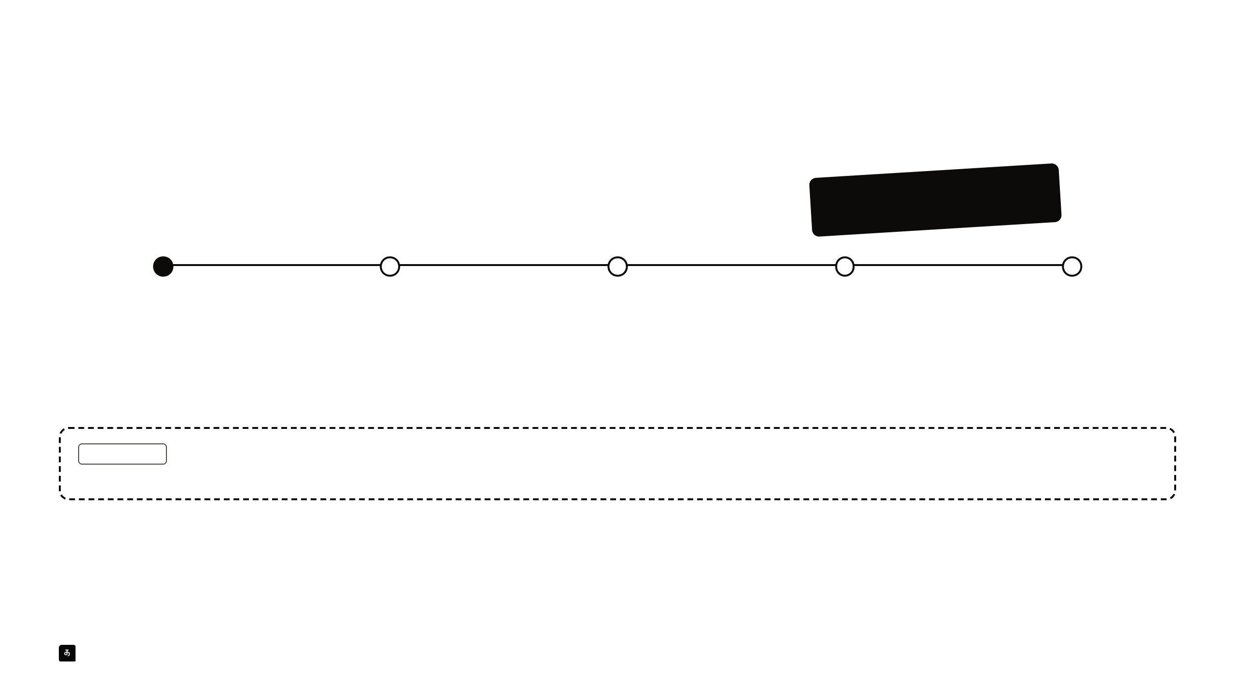
ROADMAP
Retail in December. First pilot in
February.
Nov 2026
Dec 2026
Jan 2027
Feb 2027
Apr 2027
Get ready
Retail launch
B2B discovery
First B2B pilot
B2B launch
Research Analyst certification,
The investor app goes live once
Talk to research, risk and
A real partner builds and steers
Institutional subscriptions go on
registration and incubation.
registration allows. IMM built
strategy teams. Recruit pilot
its own cause-and-effect web.
sale.
alongside.
partners.
IN PROGRESS
Accuracy validation. The AI models behind Oozh already know how past events played out, so back-tests would flatter us. We’re designing a forward
test with market experts and academics, and will publish the method and the scores, possibly after the retail launch.
Target dates. December depends on certification and registration. B2B discovery runs in parallel. Accuracy plan in appendix A6.
Oozh
09 / 11
Notes:
ROADMAP
Retail in December. First pilot in
February.
Nov 2026
Get ready
Research Analyst certification,
registration and incubation.
Dec 2026
Retail launch
The investor app goes live once
registration allows. IMM built
alongside.
Jan 2027
B2B discovery
Talk to research, risk and
strategy teams. Recruit pilot
partners.
Feb 2027
First B2B pilot
A real partner builds and steers
its own cause-and-effect web.
Apr 2027
B2B launch
Institutional subscriptions go on
sale.
IN PROGRESS
Accuracy validation. The AI models behind Oozh already know how past events played out, so back-tests would flatter us. We’re designing a forward
test with market experts and academics, and will publish the method and the scores, possibly after the retail launch.
Target dates. December depends on certification and registration. B2B discovery runs in parallel. Accuracy plan in appendix A6.
Oozh
09 / 11

Slide 10

TEAM
Khavin Shankar
“
SOLO TECHNICAL FOUNDER
We built Oozh because we wanted it as
5 years building software in regulated health-tech.
investors ourselves, my father and I.
Built the Oozh MVP, app and AI engine, in 3 months.
India is the market we know best, so we
validate here first.
Pursuing SEBI-mandated Research Analyst certification.
Why Oozh, and why India first
khavinshankar
kha.vin
Oozh
10 / 11
Notes:
TEAM
Khavin Shankar
SOLO TECHNICAL FOUNDER
5 years building software in regulated health-tech.
Built the Oozh MVP, app and AI engine, in 3 months.
Pursuing SEBI-mandated Research Analyst certification.
khavinshankar
kha.vin
“
We built Oozh because we wanted it as
investors ourselves, my father and I.
India is the market we know best, so we
validate here first.
Why Oozh, and why India first
Oozh
10 / 11

Slide 11

THE ASK
We’re seeking mentorship, AI credits, industry
connections, and early-stage support to
launch Oozh and secure our first B2B pilot.
EMAIL
WEB
admin@oozh.ai
oozh.ai
Sources and detail for every claim follow in the appendix.
Oozh
11 / 11
Notes:
THE ASK
We’re seeking mentorship, AI credits, industry
connections, and early-stage support to
launch Oozh and secure our first B2B pilot.
EMAIL
admin@oozh.ai
WEB
oozh.ai
Sources and detail for every claim follow in the appendix.
Oozh
11 / 11

Slide 12

APPENDIX · A1
Where every number comes from
FIGURE
WHAT IT IS
SOURCE
AS OF
13.5 crore
Investors registered on NSE (unique PANs)
NSE Market Pulse, Sep 2026
Aug 2026
10 lakh+
Moneycontrol Pro paid subscribers
Network18 annual report
FY25
15,000 · ₹330 to ₹500
Tijori paid subscribers, quoted by its founder, and its monthly price by plan
Entrackr · Zerodha
2025
1.08 lakh
105,314 Indian companies with 100+ staff, plus 2,403 research and advisory firms
CompanyData · RevenueBase
Oct 2026
2,350 · ₹3.6 lakh
Tracxn paying accounts, up 16% in a year, and revenue per account a year (₹21.1 crore a quarter)
Tracxn Q1 FY27 investor deck, NSE
Jun 2026
200+
Prewave enterprise customers
prewave.ai
Oct 2026
6,500+ · ~$200M
AlphaSense customers and Dataminr’s annual recurring revenue, both cited in A3
AlphaSense · Dataminr
2025
42 · 82 · 27
Effects traced, companies within reach and stock calls in one real analysis
Oozh database, final backup
Aug 2026
Oozh
A1
Notes:
APPENDIX · A1
Where every number comes from
FIGURE
WHAT IT IS
SOURCE
AS OF
13.5 crore
Investors registered on NSE (unique PANs)
NSE Market Pulse, Sep 2026
Aug 2026
10 lakh+
Moneycontrol Pro paid subscribers
Network18 annual report
FY25
15,000 · ₹330 to ₹500
Tijori paid subscribers, quoted by its founder, and its monthly price by plan
Entrackr · Zerodha
2025
1.08 lakh
105,314 Indian companies with 100+ staff, plus 2,403 research and advisory firms
CompanyData · RevenueBase
Oct 2026
2,350 · ₹3.6 lakh
Tracxn paying accounts, up 16% in a year, and revenue per account a year (₹21.1 crore a quarter)
Tracxn Q1 FY27 investor deck, NSE
Jun 2026
200+
Prewave enterprise customers
prewave.ai
Oct 2026
6,500+ · ~$200M
AlphaSense customers and Dataminr’s annual recurring revenue, both cited in A3
AlphaSense · Dataminr
2025
42 · 82 · 27
Effects traced, companies within reach and stock calls in one real analysis
Oozh database, final backup
Aug 2026
Oozh
A1

Slide 13
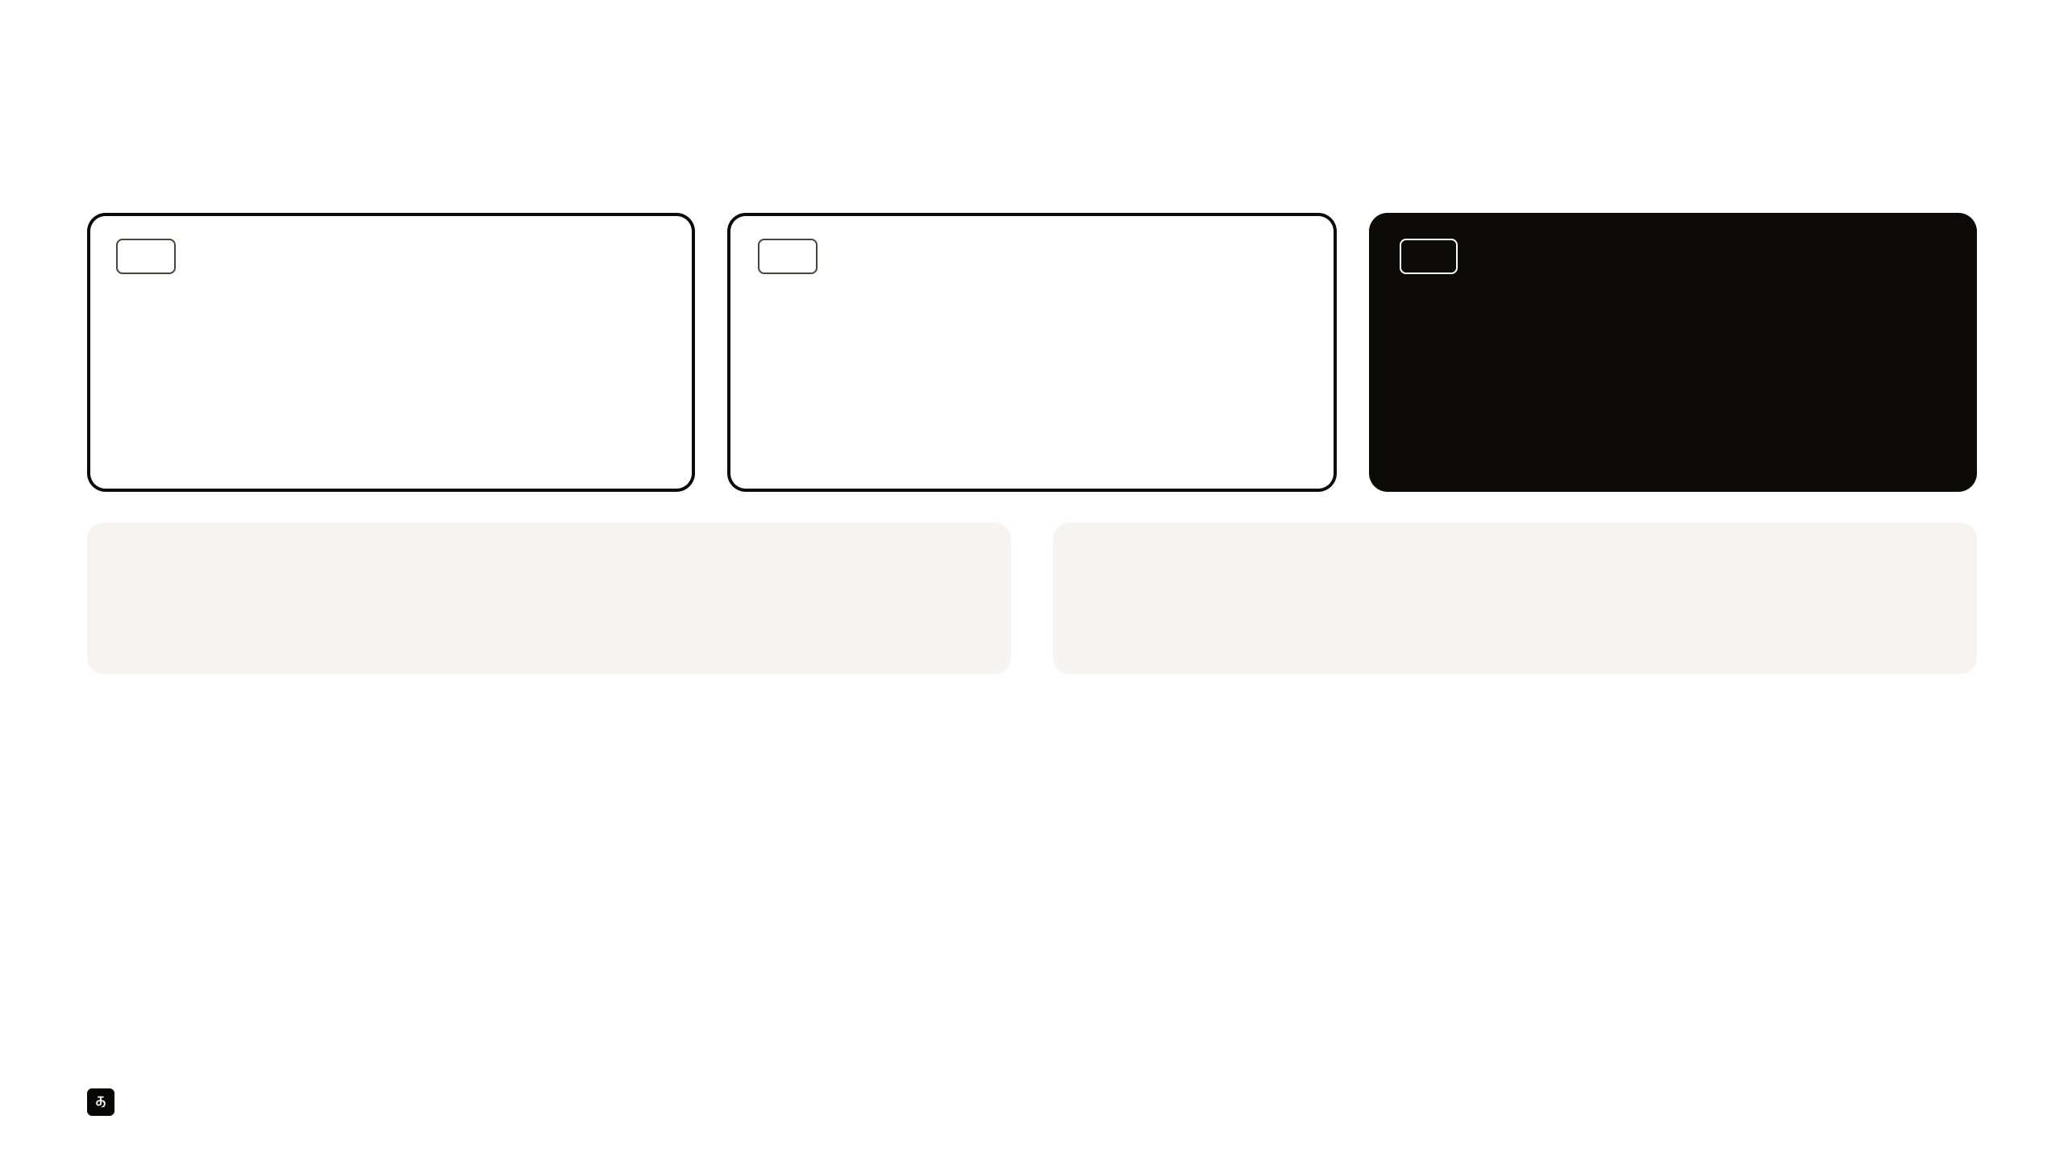
APPENDIX · A2 · RETAIL MARKET
The numbers behind 10,000 subscribers
TAM
SAM
SOM
13.5 crore
10 lakh+
10,000
Everyone registered to invest on NSE in August 2026. This
Moneycontrol Pro crossed 1 million paid subscribers in
Our 3-year goal, 1% of that paying base. The closest
is the audience, not the number willing to pay. It grew by
FY25, which shows Indian investors pay for market news
research product, Tijori, has 15,000 paid subscribers at
61.6 lakh between April and August 2026 alone.
and research. It is a broader product than Oozh, so we do
₹330 to ₹500 a month. Oozh is priced at ₹299.
not count its users as ours.
Distribution matters.
Other paid research products.
Tijori’s founder expects its Zerodha partnership to grow its paid base. Industry connections
Tickertape, Screener, Trendlyne, Value Research and MarketsMojo all sell paid plans. We could
are in our ask for the same reason.
not verify their paid counts, so none are used here.
Oozh
A2
Notes:
APPENDIX · A2 · RETAIL MARKET
The numbers behind 10,000 subscribers
TAM
13.5 crore
Everyone registered to invest on NSE in August 2026. This
is the audience, not the number willing to pay. It grew by
61.6 lakh between April and August 2026 alone.
SAM
10 lakh+
Moneycontrol Pro crossed 1 million paid subscribers in
FY25, which shows Indian investors pay for market news
and research. It is a broader product than Oozh, so we do
not count its users as ours.
SOM
10,000
Our 3-year goal, 1% of that paying base. The closest
research product, Tijori, has 15,000 paid subscribers at
₹330 to ₹500 a month. Oozh is priced at ₹299.
Distribution matters.
Tijori’s founder expects its Zerodha partnership to grow its paid base. Industry connections
are in our ask for the same reason.
Other paid research products.
Tickertape, Screener, Trendlyne, Value Research and MarketsMojo all sell paid plans. We could
not verify their paid counts, so none are used here.
Oozh
A2

Slide 14
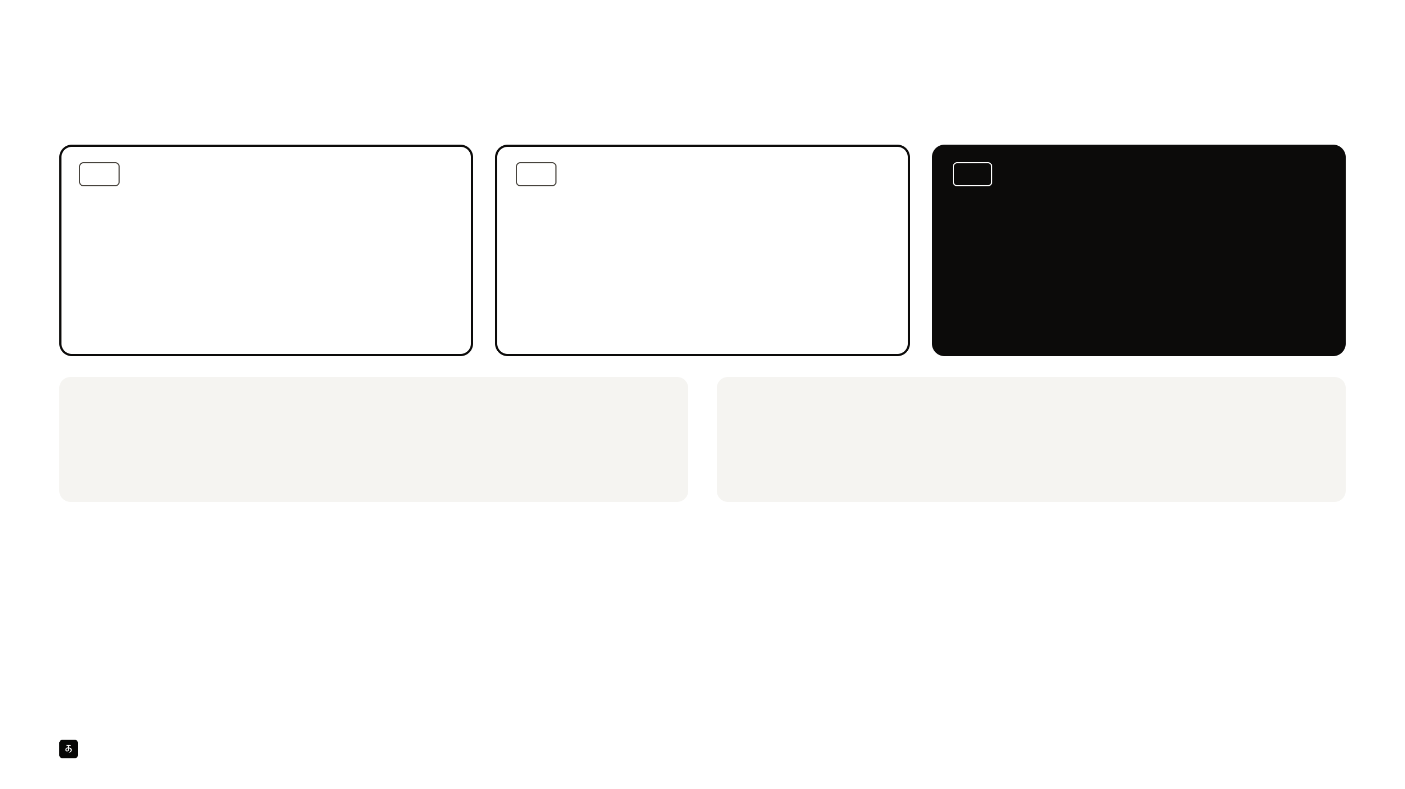
APPENDIX · A3 · INSTITUTIONAL MARKET
The numbers behind 100 organisations
TAM
SAM
SOM
1.08 lakh
2,350
100
105,314 Indian companies with 100 or more staff (53,222
Tracxn, a Bengaluru research platform, has 2,350 paying
Our 3-year goal, about 4% of Tracxn’s paying base. The
with 100 to 199, 33,239 with 200 to 499, 18,853 with 500+),
accounts, up 16% in a year. Half are investment firms and
closest product idea, Prewave, maps world events to their
plus 2,403 research and advisory firms with 1 to 50 staff.
45% are corporates, including strategy teams and
impact on a company’s suppliers and serves 200+
Third-party databases; government bodies are not
consulting firms. India is its largest market by accounts.
enterprises.
counted.
Intelligence software sells.
How we will validate.
AlphaSense has 6,500+ customers and over $500M in annual recurring revenue. Dataminr is
List 100 named Indian organisations in research, risk and strategy. Hold 20 to 30 discovery
approaching $200M, serving 100+ U.S. agencies and 20+ governments. Tracxn earns about
conversations, test paid-pilot terms, and replace these estimates with real conversion.
₹3.6 lakh a year per account.
Oozh
A3
Notes:
APPENDIX · A3 · INSTITUTIONAL MARKET
The numbers behind 100 organisations
TAM
1.08 lakh
105,314 Indian companies with 100 or more staff (53,222
with 100 to 199, 33,239 with 200 to 499, 18,853 with 500+),
plus 2,403 research and advisory firms with 1 to 50 staff.
Third-party databases; government bodies are not
counted.
SAM
2,350
Tracxn, a Bengaluru research platform, has 2,350 paying
accounts, up 16% in a year. Half are investment firms and
45% are corporates, including strategy teams and
consulting firms. India is its largest market by accounts.
SOM
100
Our 3-year goal, about 4% of Tracxn’s paying base. The
closest product idea, Prewave, maps world events to their
impact on a company’s suppliers and serves 200+
enterprises.
Intelligence software sells.
AlphaSense has 6,500+ customers and over $500M in annual recurring revenue. Dataminr is
approaching $200M, serving 100+ U.S. agencies and 20+ governments. Tracxn earns about
₹3.6 lakh a year per account.
How we will validate.
List 100 named Indian organisations in research, risk and strategy. Hold 20 to 30 discovery
conversations, test paid-pilot terms, and replace these estimates with real conversion.
Oozh
A3

Slide 15
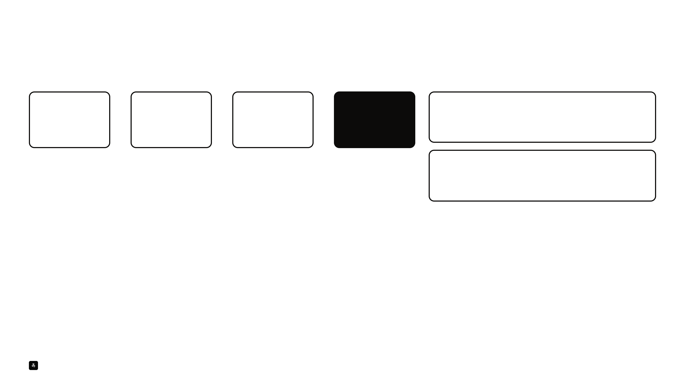
APPENDIX · A4 · PROOF OF WORK
One real story, start to finish
“U.S. Iran pressure campaign raises energy-market risk” · CNBC · analysed 15 August 2026
42
5,147
82
27
Oil India
▲ Bullish
effects, three levels
→
listed Indian
→
within reach of the
→
with a call
+2 to +6% · 5 to 45 days · conviction 55
deep
companies checked
effects
It sells crude, so a higher price lifts what it earns per barrel.
One CNBC story about U.S. pressure on Iran set off 42 effects, three levels deep. Oozh checked which of 5,147 listed Indian
Indian Oil
▼ Bearish
companies they could reach and found 82. It weighed 250 links between effects and companies, kept the 119 that held up, and
−9 to −4% · 1 to 60 days · conviction 65
made calls on 27 stocks: 3 bullish, 7 bearish, 16 to watch and 1 neutral. Its closest historical parallel was the 1980s Tanker War, a
It buys crude, so the same rise squeezes its refining margins.
65% match.
Figures as recorded in the analysis run. Illustrative, not a forecast or a recommendation.
Oozh
A4
Notes:
APPENDIX · A4 · PROOF OF WORK
One real story, start to finish
“U.S. Iran pressure campaign raises energy-market risk” · CNBC · analysed 15 August 2026
42
effects, three levels
deep
→
5,147
listed Indian
companies checked
→
82
within reach of the
effects
→
27
with a call
One CNBC story about U.S. pressure on Iran set off 42 effects, three levels deep. Oozh checked which of 5,147 listed Indian
companies they could reach and found 82. It weighed 250 links between effects and companies, kept the 119 that held up, and
made calls on 27 stocks: 3 bullish, 7 bearish, 16 to watch and 1 neutral. Its closest historical parallel was the 1980s Tanker War, a
65% match.
Oil India
▲ Bullish
+2 to +6% · 5 to 45 days · conviction 55
It sells crude, so a higher price lifts what it earns per barrel.
Indian Oil
▼ Bearish
−9 to −4% · 1 to 60 days · conviction 65
It buys crude, so the same rise squeezes its refining margins.
Figures as recorded in the analysis run. Illustrative, not a forecast or a recommendation.
Oozh
A4

Slide 16
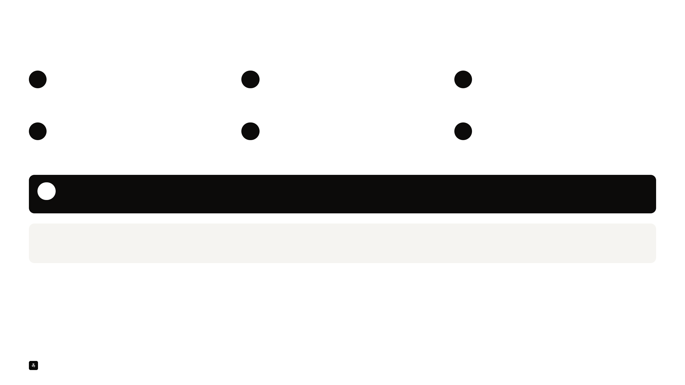
APPENDIX · A5 · METHODOLOGY
How Oozh reasons
1
Watch
2
Understand
3
Trace
Reads trending financial news every day, merges
Builds context for each event that survives: a summary,
AI proposes effects level by level, each with a reason and
duplicate coverage into one event, and scores each event
what, why, when, where and who, and its sources.
a confidence score. Every effect is challenged before it’s
for market relevance. Low-value stories are dropped.
kept.
4
Recall
5
Match
6
Call
Compares the event with past events to find historical
Maps the surviving effects onto 5,147 listed Indian
For each company that remains: a stance, a conviction
parallels, and says where each parallel stops holding.
companies. Every company link is challenged, and weak
score out of 100, a projected price band and a time
ones are dropped.
horizon.
7
Reality check
Each call will be compared with what actually happened. We’ll publish the hits, the misses and the shortcomings, and use them to keep improving.
AI does the reading. Analysts do the steering.
For investors, in-house SEBI-registered Research Analysts will navigate and steer Oozh’s analysis. Registration is in progress, and the retail launch waits for it.
Oozh
A5
Notes:
APPENDIX · A5 · METHODOLOGY
How Oozh reasons
1
Watch
Reads trending financial news every day, merges
duplicate coverage into one event, and scores each event
for market relevance. Low-value stories are dropped.
2
Understand
Builds context for each event that survives: a summary,
what, why, when, where and who, and its sources.
3
Trace
AI proposes effects level by level, each with a reason and
a confidence score. Every effect is challenged before it’s
kept.
4
Recall
Compares the event with past events to find historical
parallels, and says where each parallel stops holding.
5
Match
Maps the surviving effects onto 5,147 listed Indian
companies. Every company link is challenged, and weak
ones are dropped.
6
Call
For each company that remains: a stance, a conviction
score out of 100, a projected price band and a time
horizon.
7
Reality check
Each call will be compared with what actually happened. We’ll publish the hits, the misses and the shortcomings, and use them to keep improving.
AI does the reading. Analysts do the steering.
For investors, in-house SEBI-registered Research Analysts will navigate and steer Oozh’s analysis. Registration is in progress, and the retail launch waits for it.
Oozh
A5

Slide 17
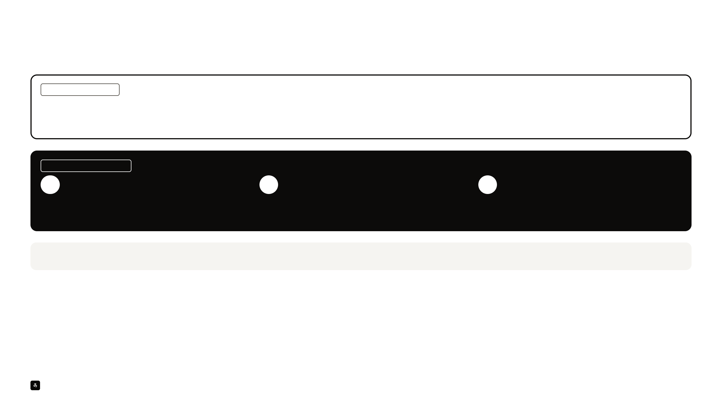
APPENDIX · A6 · ACCURACY VALIDATION
Back-tests would flatter us. So we’re building a better test.
WHY NOT BACK-TESTS
It’s like grading a student on a test they’ve already seen.
Oozh runs on frontier models such as GPT and Claude, trained on recent data. They have already read how past events ended, so a back-test would score their memory, not their reasoning.
WHAT WE’RE WORKING ON
1
Designing a better method
2
Next, a second opinion
3
Then, test and publish
Working out how calls get recorded and scored, and
Market experts and academics will review and verify
We’ll run the accuracy tests and publish the results,
against which simple baselines, with no hindsight.
the method before any test runs.
hits and misses alike, verified through SEBI’s PaRRVA
framework.
Until then, we make no accuracy claims.
Oozh
A6
Notes:
APPENDIX · A6 · ACCURACY VALIDATION
Back-tests would flatter us. So we’re building a better test.
WHY NOT BACK-TESTS
It’s like grading a student on a test they’ve already seen.
Oozh runs on frontier models such as GPT and Claude, trained on recent data. They have already read how past events ended, so a back-test would score their memory, not their reasoning.
WHAT WE’RE WORKING ON
1
Designing a better method
Working out how calls get recorded and scored, and
against which simple baselines, with no hindsight.
2
Next, a second opinion
Market experts and academics will review and verify
the method before any test runs.
3
Then, test and publish
We’ll run the accuracy tests and publish the results,
hits and misses alike, verified through SEBI’s PaRRVA
framework.
Until then, we make no accuracy claims.
Oozh
A6

